Slide 1
COMMANDS

Slide 2
Docker build
docker build [OPTIONS] PATH | URL | -
Use
Examples
Build image from git repositories / tarball contexts / plain text files
docker build https://github.com/docker/rootfs.git#container:docker
docker build http://server/context.tar.gz
docker build - < Dockerfile

Slide 3
Docker tag
docker tag SOURCE_IMAGE[:TAG] TARGET_IMAGE[:TAG]
Use
Specifications
Examples
Tag an image referenced by ID / name / name and tag
docker tag 0e5574283393 fedora/httpd:version1.0
docker tag test fedora/httpd:version1.0
docker tag test/test-tag fedora/httpd:version1.0

Slide 4
Docker commit
docker commit [OPTIONS] CONTAINER [REPOSITORY[:TAG]]
Use
Specifications
Options
Examples
Commit a container / commit with options
docker commit c3f279d17e0a shakthi4real/try:4
docker commit --change "ENV DEBUG=true" c3f279d17e0a shakthi4real/try:4

Slide 5
Docker image
Parent command
ls , pull , push , tag , history , prune
Example:
docker image ls
docker image pull openjdk
docker import https://example.com/exampleimage.tgz

Slide 6
Docker pull
docker pull [OPTIONS] NAME[:TAG|@DIGEST]
Use
Specifications
Examples
Pull from hub / by version , digest / from some registry
docker pull debian
docker pull ubuntu:14.04
docker pull ubuntu@sha256:82becede498899ec668628e7cb0ad87b6e1c371cb8a1e597d83a47fac21d6af
docker pull registry:5000/testing/image

Slide 7
Docker push
docker push [OPTIONS] NAME[:TAG]
Use
Specifications
Options
Examples
docker push shakthi4real/try:4

Slide 8
Docker rm
docker rm [OPTIONS] CONTAINER [CONTAINER...]
Use
Examples
docker rm /redis
docker rm –force redis
docker rm –v redis

Slide 9
Docker rmi
docker rm [OPTIONS] CONTAINER [CONTAINER...]
Use
Specifications
Examples
docker rmi try:latest
docker rmi –f fd484f19954f
docker rmi localhost:5000/test/busybox@sha256:cbbf2f9a99b47fc460d422812b6a5adff7dfee951d8fa2e4a98caa0382cfbdbf

Slide 10
Docker run
docker run [OPTIONS] IMAGE [COMMAND] [ARG...]
Use
Examples
docker run --name test -it debian
root@(container_id)/#
-d
--dns
--pull

Slide 11
Container
What

Slide 12
Container
What
Use

Slide 13
Container
What
Use
Behaviour

Slide 14
Image
What

Slide 15
Image
What
Use

Slide 16
Image
What
Use
Behaviour

Slide 17
Image
What
Use
Behaviour
Advantage

Slide 18
Image
What
Use
Behaviour
Advantage
Convention

Slide 19
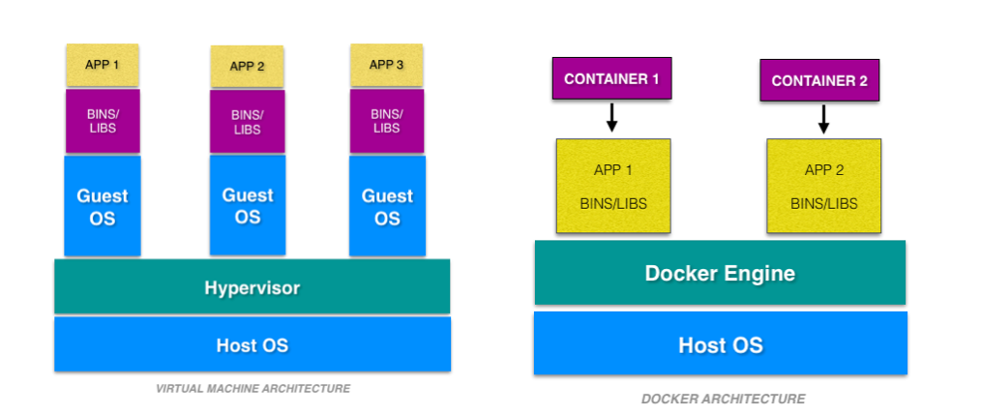
VM vs Container

Slide 20
VM vs Container
Virtualisation
Resource
Time
Advantages over virtual machine

Slide 21
To do!
Commands
Java Application in docker
STDIN

